Slide 1
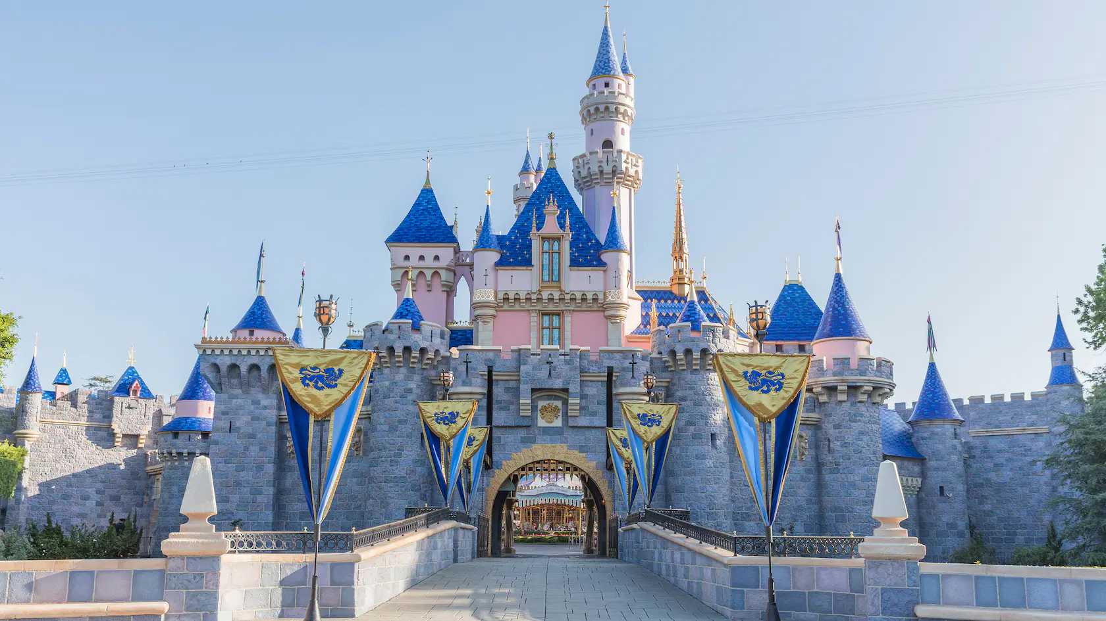
Disneyland Reviews:
An NLP Report
By: Gabe Owens, Alex Sington, Hsuan-Ting (Tommy) Wu

Slide 2
Executive Summary
1
Topic
Analyze Disneyland Reviews from 3 of their Branches (California, Hong Kong and Paris)
Sentiment Analysis
Text Preprocessing, Visualizations, Encodings /Manipulations, Model Building, Model Selection (Logistic Regression), Performance Metrics /Analysis
2
3
Topic Modeling
Text Preprocessing, Visualizations, Model Building, Determine Topics, Analyze, Repeat for all Branches
4
Results
Conclusions and recommendations based on joint findings

Slide 3
Business Scope
Topic Modeling
Sentiment analysis can be used by Disney to automatically classify and analyze the sentiment (positive, negative, or neutral) of large volumes of text data, such as customer reviews, social media posts, and survey responses (independent of the “star” rating of the review). This can provide valuable insights into customer opinions and preferences, and help businesses to identify areas for improvement in their products or services.
Sentiment analysis can also be used to monitor and track changes in customer sentiment over time. For example, Disney could use sentiment analysis to track the overall sentiment of customer reviews for a particular branch/location or product, and use this information to identify trends and changes in customer satisfaction.
Additionally, sentiment analysis can be used in conjunction with other natural language processing techniques, such as topic modeling, to gain deeper insights into customer feedback. For example, a business could use sentiment analysis to determine the overall sentiment associated with specific topics or themes identified through topic modeling, and use this information to prioritize areas for improvement in their products or services.
Topic modeling can be used by Disney to automatically organize and categorize large collections of text data (in this case customer reviews). This can make it easier to analyze and understand the topics and sentiments that are prevalent in their customer feedback.
Topic modeling can also be used to improve document search and retrieval, by identifying the main topics in a document and using those topics as keywords for search queries. This can help Disney to quickly find relevant documents and information within their internal review databases.
Additionally, topic modeling can be used in conjunction with other natural language processing techniques, such as sentiment analysis, to gain deeper insights into customer opinions and preferences. For example, Disney could use topic modeling to identify the main topics of discussion in customer reviews, and then use sentiment analysis to determine the overall sentiment (positive, negative, or neutral) associated with those topics. This can provide valuable information for businesses looking to improve their products or services based on customer feedback.
Sentiment Analysis

Slide 4
Data Source Info
42,000 Reviews of 3 Disneyland Branches (Paris, California and Hong Kong) by visitors on Tripadvisor
Variable | Definition
Review_ID | Unique id for each review
Rating | From 1 (unsatisfied) to 5 (satisfied)
Year_Month | Date reviewer visited theme park
Reviewer_Location | Country of origin of visitor
Review_Text | Comments made by visitor
Disneyland_Branch | Location of Disneyland Park
Only variables in green and the first 10,000 rows were used

Slide 5
Model Text Preprocessing
1
Regex cleaning
2
Remove stopwords
3
Drop uncommon words
- Remove punctuation
- Convert to lowercase
- Remove common entities via Textacy
- Clean out Disney location references
- Remove common stopwords that didn’t add value to our model
- Added 42 custom stopwords
- Drop words with less than 5 appearances

Slide 6
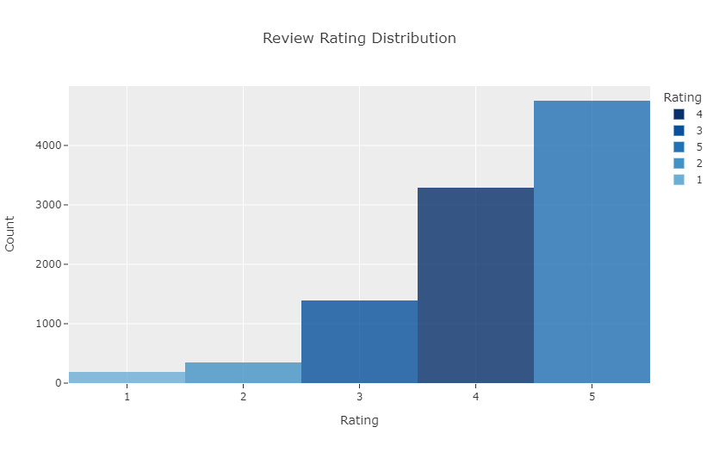
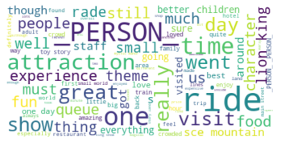
EDA Visualizations
Most common words seems to be on the positive side, along with themes related people and attraction names.
There were very few negative reviews, while ratings 4 and 5 took up the majority.

Slide 7
Sentiment Analysis

Slide 8
Sentiment Analysis Overview
1
Goal
Build a model that can classify reviews into either positive, neutral, or negative reviews
2
Data
75% will be used for training the model while the other 25% will be used for testing its performance
3
Exploration
Use countvectorizer and to explore patterns in the data
4
Method
Experiment with various machine learning models

Slide 9
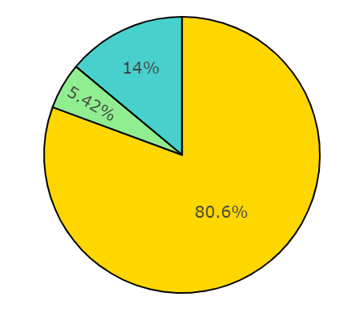

Categorization of Ratings
Due to the large number of 4 and 5 ratings, we decided to categorize them as positive.
Sentiment Distribution
Positive
Ratings: 4 and 5
Neutral
Ratings: 3
Negative
Ratings: 1 and 2

Slide 10
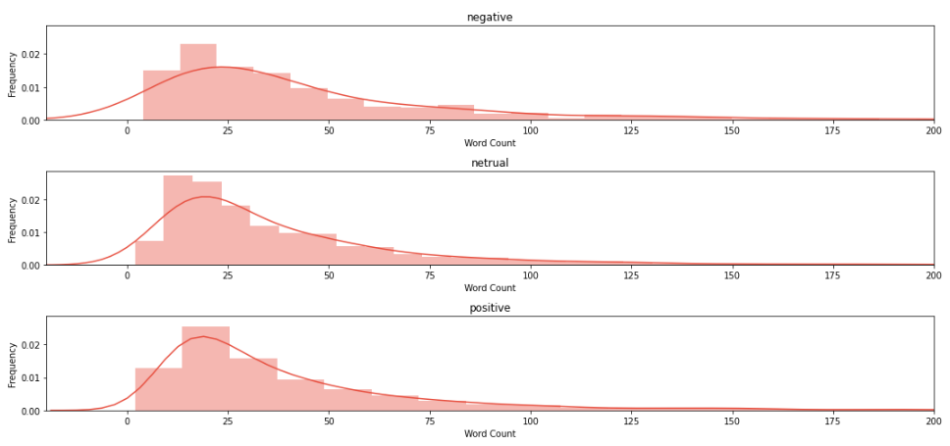
Word Count by Review Type
Negative reviews seems to have a higher chance of having more words in the review

Slide 11
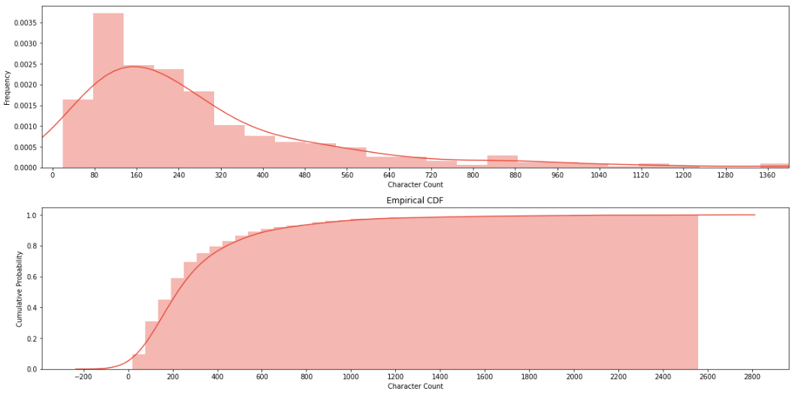
Character Count - Negative Reviews
Similar to word count, negative reviews seems to have more characters in them

Slide 12
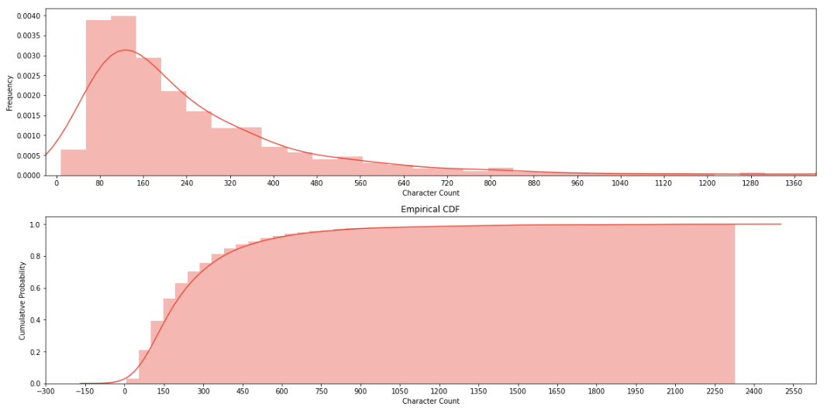
Character Count - Neutral Reviews
Neutral reviews have a lower character count than negative reviews

Slide 13
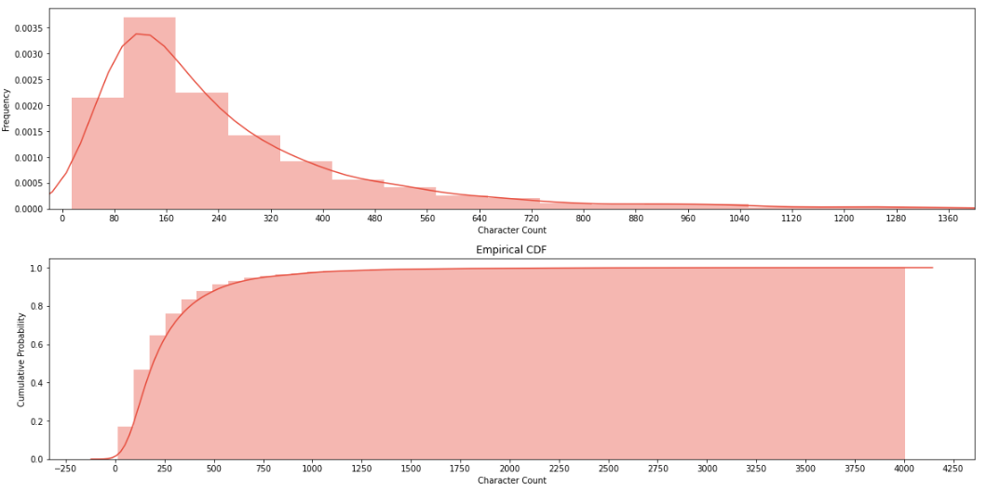
Character Count - Positive Reviews
Positive reviews have a similar pattern with neutral reviews

Slide 14
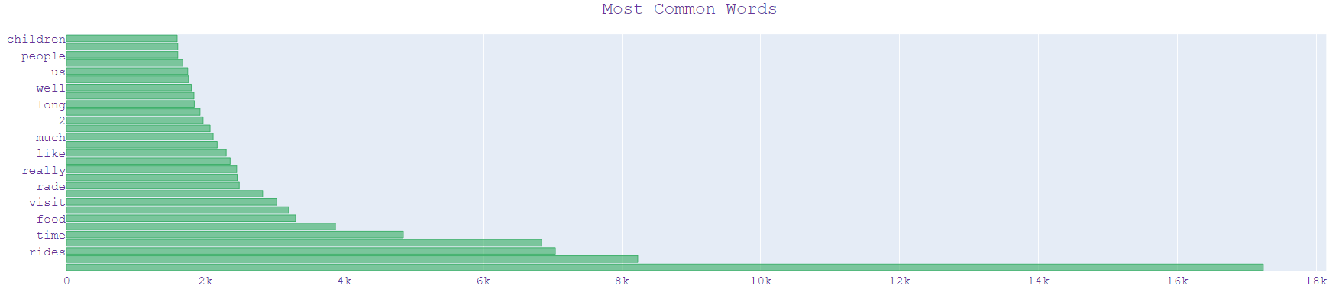
Most Common words
The most commons words in all reviews does not have many indication on whether they are positive, neutral or negative

Slide 15
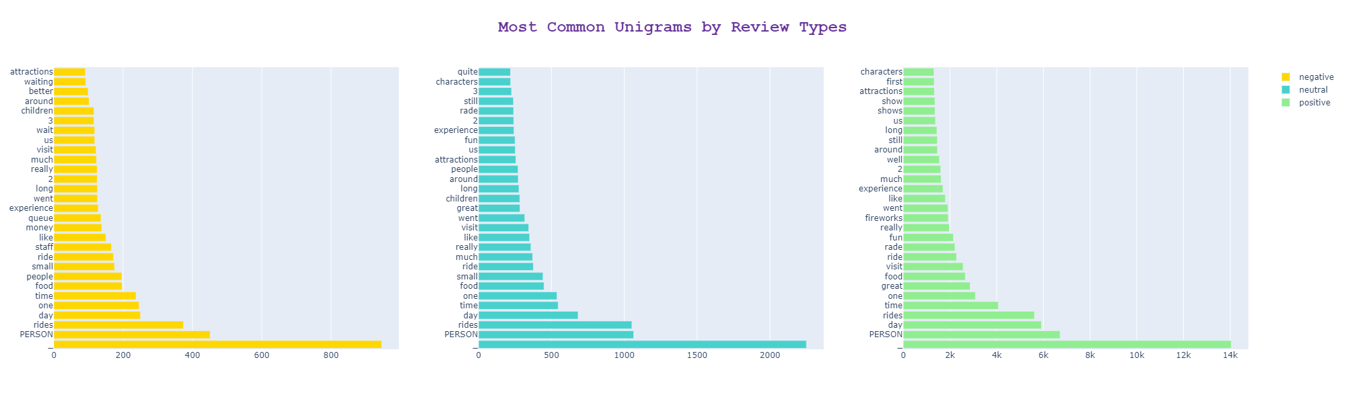
Most Common Unigrams by Review Type
In terms of unigrams, negative reviews have some specific words such as “queue”, “money”, “long”, and “waiting”. Positive reviews have their own words such as “great”, “fun” and “fireworks”.

Slide 16
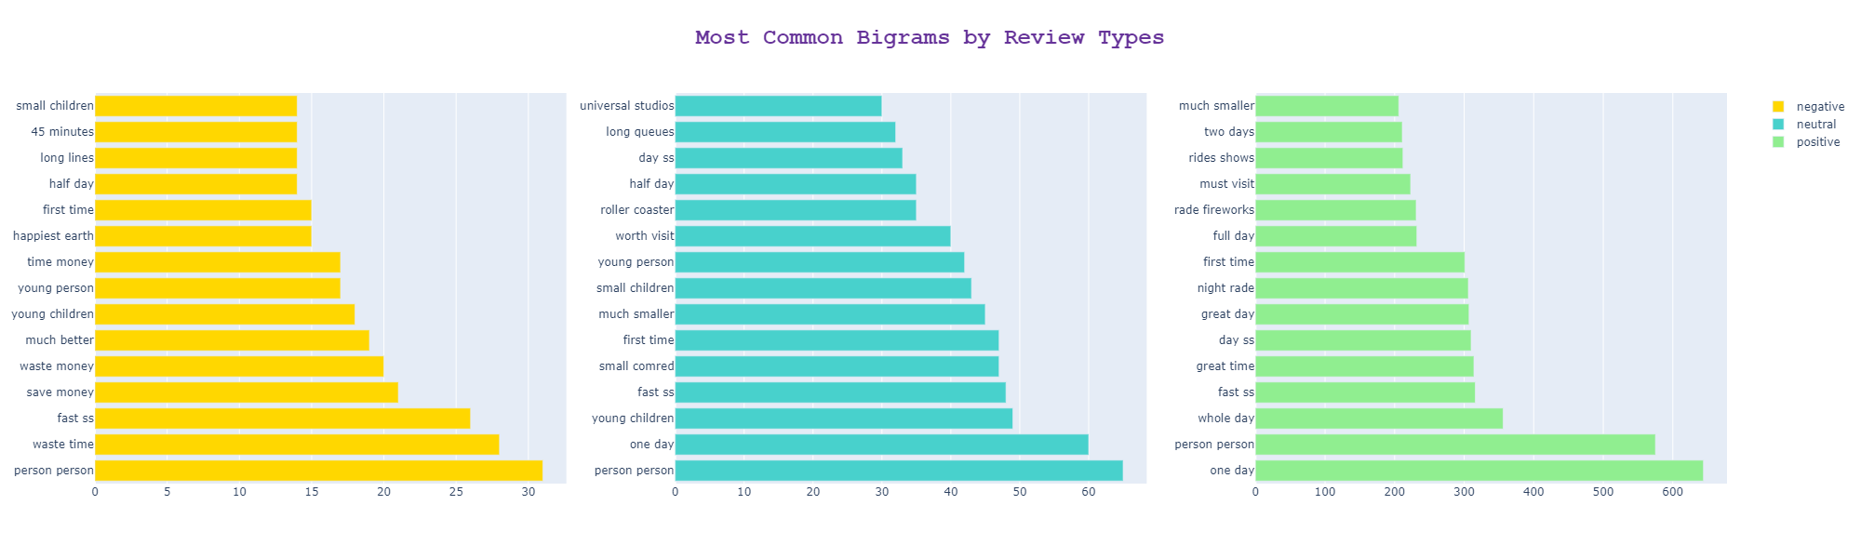
Most Common Bigrams by Review Type
The message is clearer in bigrams, where negative reviews have phrases such as “waste time”, “young children”, and “long lines”. On the other hand, positive reviews have phrases like “great time”, “rade fireworks”.

Slide 17
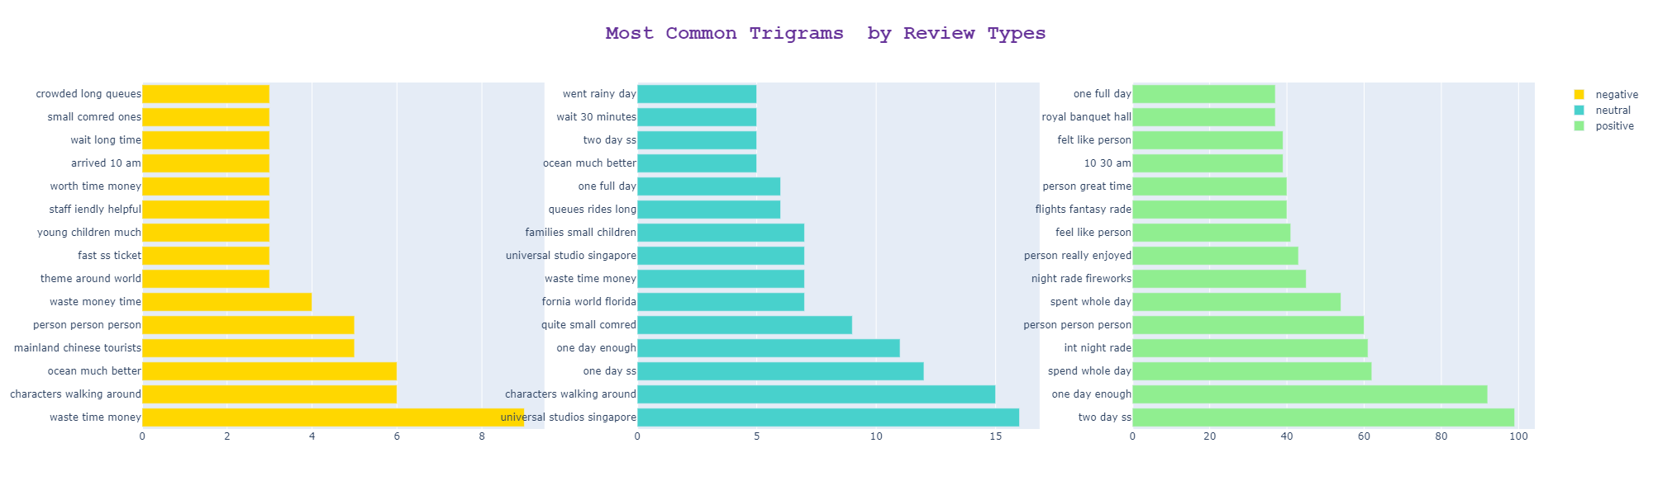
Most Common Trigrams by Review Type
In trigrams, negative reviews have phrases such as “waste time money”, “mainland chinese tourists”, and “young children much”. On the other hand, neutral reviews also have similar phrases, which could indicate some neutral reviews may in fact be negative.

Slide 18
Model Building Steps
1
TFIDF
2
Handle imbalance
3
Train test split
4
Build and tune models
Due to there being way more positive reviews in the dataset, we use Synthetic Minority Oversampling Technique (SMOTE) to oversample the minority class, thus making the data set more balanced
Perform TFIDF vectorization to find the frequency and importance of each word
Split the data set into training and testing in a 75:25 ratio
Experiment with different machine learning models and tune their parameters

Slide 19
Models Built
Model | Testing Accuracy
Logistics Regression | 0.8127
SVC | 0.8078
Naive Bayes | 0.7676
Decision Tree | 0.7327
KNN | 0.6568
We attempted 5 different models using their default parameters.
Logistics regression had the best performance, so we will try to fine tune it to get a better result.

Slide 20
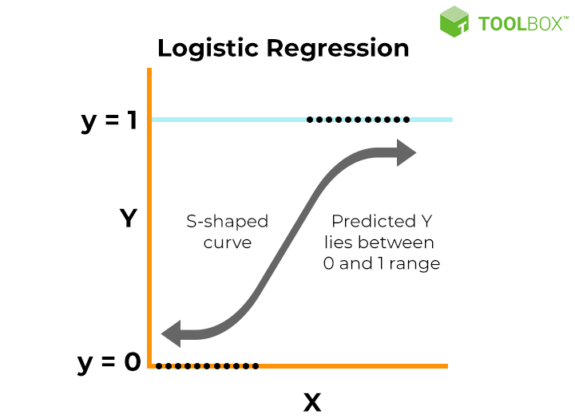
Final Model - Logistics Regression
Logistic regression is a statistical method that is used for building machine learning models where the dependent variable is dichotomous: i.e. binary. Logistic regression is used to describe data and the relationship between one dependent variable and one or more independent variables.
Utilized grid search to fine tune the model.
Hyperparameters:
C = 10000
Random_state = 0
Testing accuracy: 0.9125
https://www.simplilearn.com/tutorials/machine-learning-tutorial/logistic-regression-in-python

Slide 21
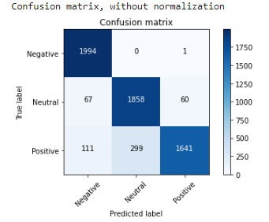
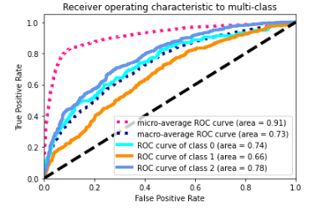
Model Evaluation - Metrics
 | Precision | Recall | F1 score | Support
Negative | 0.92 | 1.00 | 0.96 | 1995
Neutral | 0.86 | 0.94 | 0.90 | 1985
Positive | 0.96 | 0.80 | 0.87 | 2051
Accuracy |  |  | 0.91 | 6031
Macro avg | 0.92 | 0.91 | 0.91 | 6031
Weighted avg | 0.92 | 0.91 | 0.91 | 6031

Slide 22
Topic Modeling Analysis

Slide 23
Topic Modeling Overview
1
Goal
Identity different type of areas that Disneyland can improve on by analyzing negative reviews
2
Data
Only use reviews where ratings are <= 3
3
# of topics
Explore 3 different topics
4
Method
Latent Dirichlet Allocation (LDA), Non-Negative Matrix Factorization algorithms

Slide 24
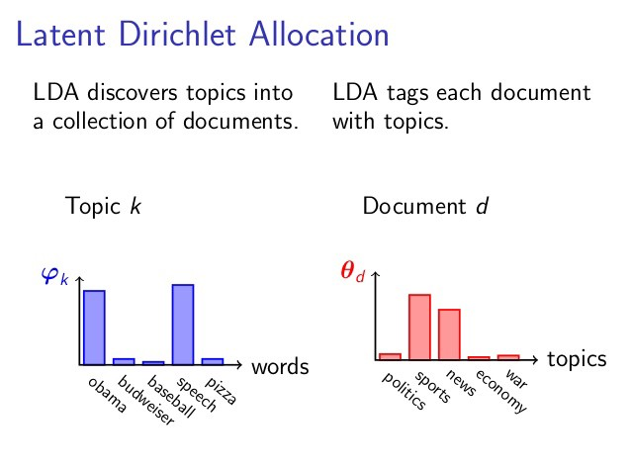
Latent Dirichlet Allocation (LDA)
LDA is a three-level hierarchical Bayesian model, in which each item of a collection is modeled as a finite mixture over an underlying set of topics. Each topic is, in
turn, modeled as an infinite mixture over an underlying set of topic probabilities.
https://www.jmlr.org/papers/volume3/blei03a/blei03a.pdf

Slide 25
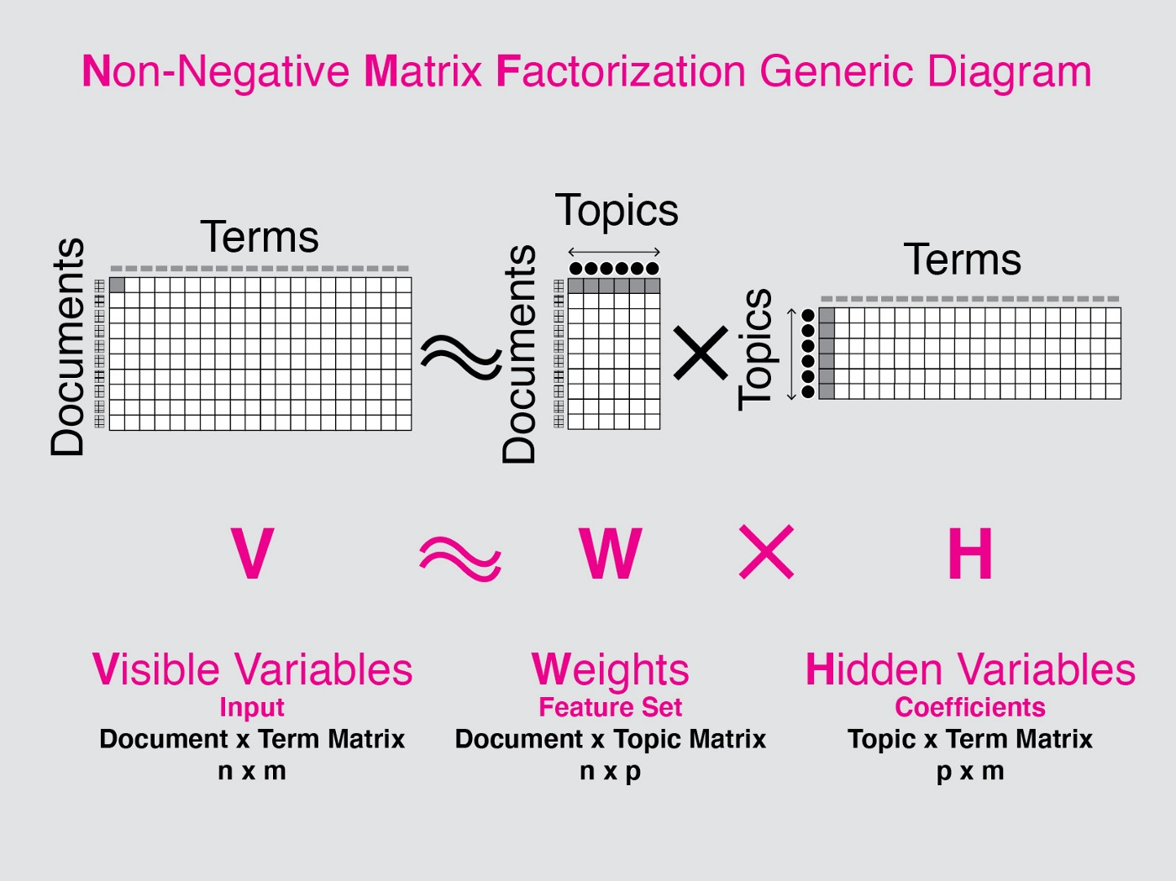
Non-Negative Matrix Factorization
Non-Negative Matrix Factorization: For a matrix A of dimensions m x n, where each element is ≥ 0, NMF can factorize it into two matrices W and H having dimensions m x k and k x n respectively and these two matrices only contain non-negative elements.
https://www.geeksforgeeks.org/non-negative-matrix-factorization/

Slide 26
Hong Kong
1
Topic Themes
2
Recommendations
Park is not well-designed to handle large crowds
Smaller park with fewer rides and attractions compared to other Disney parks
Not much to offer for non-kids
Add more rides that apply to an older audience
Add more park entrance gates to streamline people into the park

Slide 27
California
1
Topic Themes
2
Recommendations
Explore the possibility of letting fewer people into the park. While this may hurt revenue in the short term, this will lead to better customer experiences and more repeat customers in the long term.
Clearly state online all rides/attractions that are closed for the day, so customers are not left disappointed.
Park is wildly overcrowded
Rides are frequently closed for maintenance

Slide 28
Paris
1
Topic Themes
2
Recommendations
Implement a staff training program to encourage employees to embody the Disney spirit (positive energy) and improve the speed and quality of service (for food staff, in particular)
Invest into cleaning up and renovating the park (e.g., repainting walls and statues, trimming shrubs, etc.)
Either limit or ban smoking within the park
Park is run-down and dirty
Service is slow
Staff members may have negative/indifferent attitudes

Slide 29
Conclusion - Common Themes for All Parks
“You have to approach Disney with the knowledge that it is over priced and crowded.”
1
Topic Themes
2
Recommendations
Between the cost of tickets, food, hotels, and any other products/services (Disney charges for everything), visiting Disneyland is extremely expensive, and the overall experience does not match the price.
Wait times are very long
Food is expensive, low-quality, and limited in variety.
Rides are frequently closed unexpectedly for maintenance
Create an app that allows customers to book spots on rides during peak hours to minimize wait time.
Offer wider variety of food (not just fast food)
Spend more time on ride maintenance up front (before problems come up) to avoid unexpected ride closures.

